Slide 1
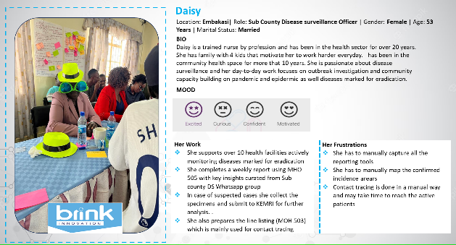
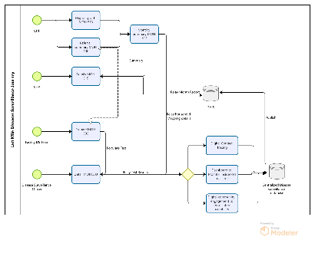
Disease Surveillance
BRINK INNOVATION
Develop a robust a disease surveillance solution that will deliver
Digital mapping capability
Digitize all the MOH reports
Dashboards to support in disease surveillance reporting & monitoring
To be designed as part of validating the hypothesis
DIGITAL
Digitization through provision of online forms
Digital Mapping & tagging incidences in real-time
Sensitization of personas on importance of digitization
Provision of laptops, phones, internet and tablets
Data tracking , storage and data back up using digital servers
Providing digital network for transmitting data
Provision of digital line list for visits/ mapping tool reports
Leverage data collected to aggregate MOH summaries and ingest reports to DHIS
Virtual access to patients during difficult times e.g. at night or during conflicts
Capacity Building
On demand access to diseases surveillance standard case definition training modules
Educate the community on the importance of these visits and importance of good health.
Plan for continuous technical support and capacity building for CHA & CHP
Phycological and mental health support for the CHP/CHA
Online training forums to continuously deliver best practices to the team.
Incentives
Better allowances and incentive packages to CHP/CHA
Facilitate PPE’s and transport allowances
Basic knowledge of digital tools usage
Digitizing the MOH 513 is critical to the success of the entire project
Digitization of MOH 513, 100 reports will reduce the CHA workload by 40%
Digitization of MOH515 reports will reduce the CHP workload by 40%
Digitization of the MOH DS forms will result in timely submission of Reports
Digitization of the MOH DS forms will improve the data accuracy by 80%
TBA
Digitization of MOH 513, 100,will automatically curate MOH 514 & 515
To be Designed
To be Designed
To be Designed
To be Designed
To be Designed
To be Designed
Digitization of MOH 502, 503,will improve response time through accurate contact tracing
To be Defined
To be Defined
To be Defined
To be Defined
To be Defined
To be Defined
NA
Yet to start
Yet to start
Yet to start
Yet to start
Yet to start
Yet to start
NA
Yet to start
Yet to start
Yet to start
Yet to start
Yet to start
Yet to start
Digitize MOH Forms
Digitize the DS Mapping process
Integrated communication solution to alert and inform all stakeholders in the value chain in case of any cases
NA
Yet to start
Yet to start
Yet to start
Yet to start
Yet to start
Yet to start

